Slide 1
California’s Rural Counties
Challenges & Opportunities
Maura Twomey, Executive Director
Association of Monterey Bay Area Governments
Notes:
Introduction.

Slide 2
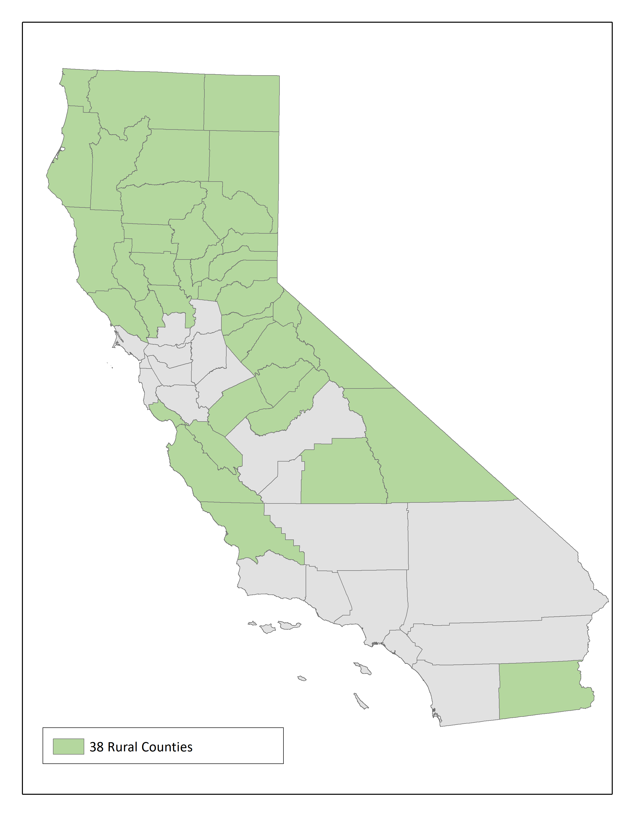
California’s
Rural Counties
2
Notes:
The 38 rural counties highlighted on the map represent more than half of California’s counties (58) and more than half (58%/91614 square miles) of California’s land mass (155,779 square miles). California’s rural counties range from forested and mountainous landscapes to coastal regions, desert regions and farm and vineyard land. Rural California provides food, water and recreation to residents and visitors from across the state and country.

Slide 3
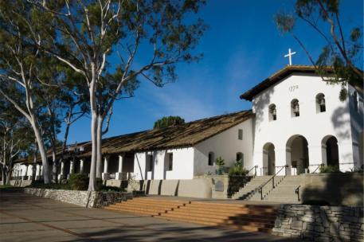
California’s Rural Counties
5 million population (2.1 million in the 26 most rural counties)
$27 billion agricultural production5
$28 billion tourism industry
16 million acres of U.S. Forest Service land
$420 million timber production
4
Notes:
Though large in geographic area, the California’s Rural Counties are sparsely populated, totaling only 5 million people in the 38 counties, about 12% of California’s total population of 38.8 million. Primarily rural in nature, their economies are primarily based on agriculture and tourism.
The rural counties contribute nearly half (47%) of California’s total agriculture production and nearly all (98%) of the state’s timber production.

Slide 4
Rural Highway Miles in California
10,259 SHS Centerline Miles
1,186 Rural Interstate Miles5
369 Rural Freeway/Expressway Miles
5
Notes:
California’s State Highway System consists of more than 15,000 Centerline Miles (15,086) of which 68% are in rural regions of the state. Across this vast system of rural highway travels nearly $90 billion in freight, sending food and raw materials across the state and nation and critical finished goods and products to rural communities.
Freight movement is critical to California and especially critical to its rural regions. The economies of many of California’s rural counties are dependent on safe, efficient and timely freight movement.

Slide 5
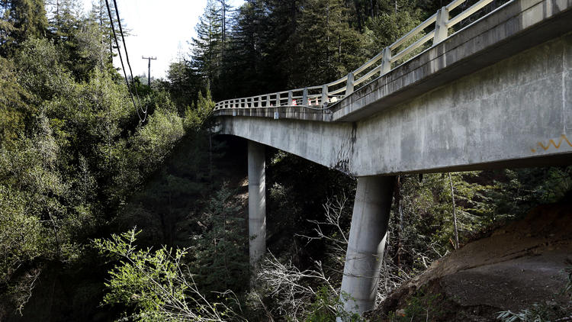
Rural Transportation Challenges
Road Condition
Safety5
Weather
Funding
6
Notes:
So what are the challenges for rural freight movement in California? Although rural California struggles with many of the same challenges as urban California, Road Conditions, Safety, Weather and Funding are especially challenging for rural counties.

Slide 6
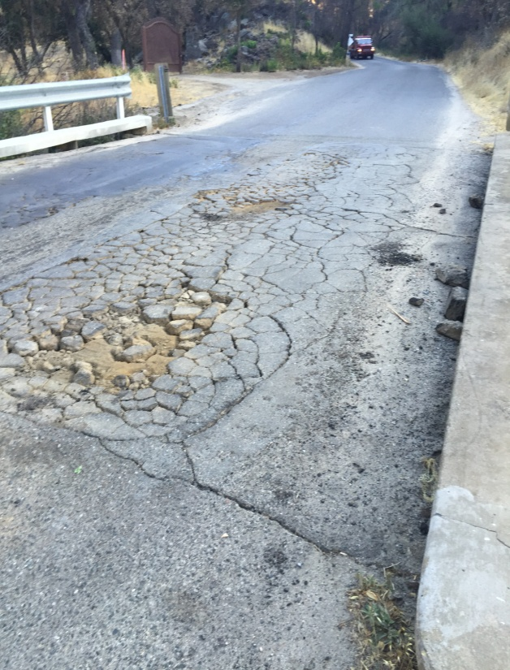
Rural Freight Challenges
Road Condition
32% of rural roads rated in poor condition
9% of rural bridges rated poor5
Not built to current standards
Lack adequate capacity5
5
7
Notes:
32% of California rural roads are rated in poor condition, which is second highest in the nation. 24% are rated in mediocre condition.
9% of California’s rural bridges are rated poor or structurally deficient. Bridges in poor condition or that are structurally deficient have significant deterioration to the bridge and are often posted for lower weight or closed to traffic, restricting or redirecting commercial trucks. As the majority of freight in California’s rural counties travels by truck, such restrictions or closures severely hamper the efficient movement of freight.
In addition, many rural highways are older and were not built to current design standards. In particular, many rural highways are not build to STAA standards and are unable to accommodate commercial trucks.
Even where rural highways are built to accommodate commercial trucks, many highways lack adequate capacity for the flow of freight through rural regions.

Slide 7
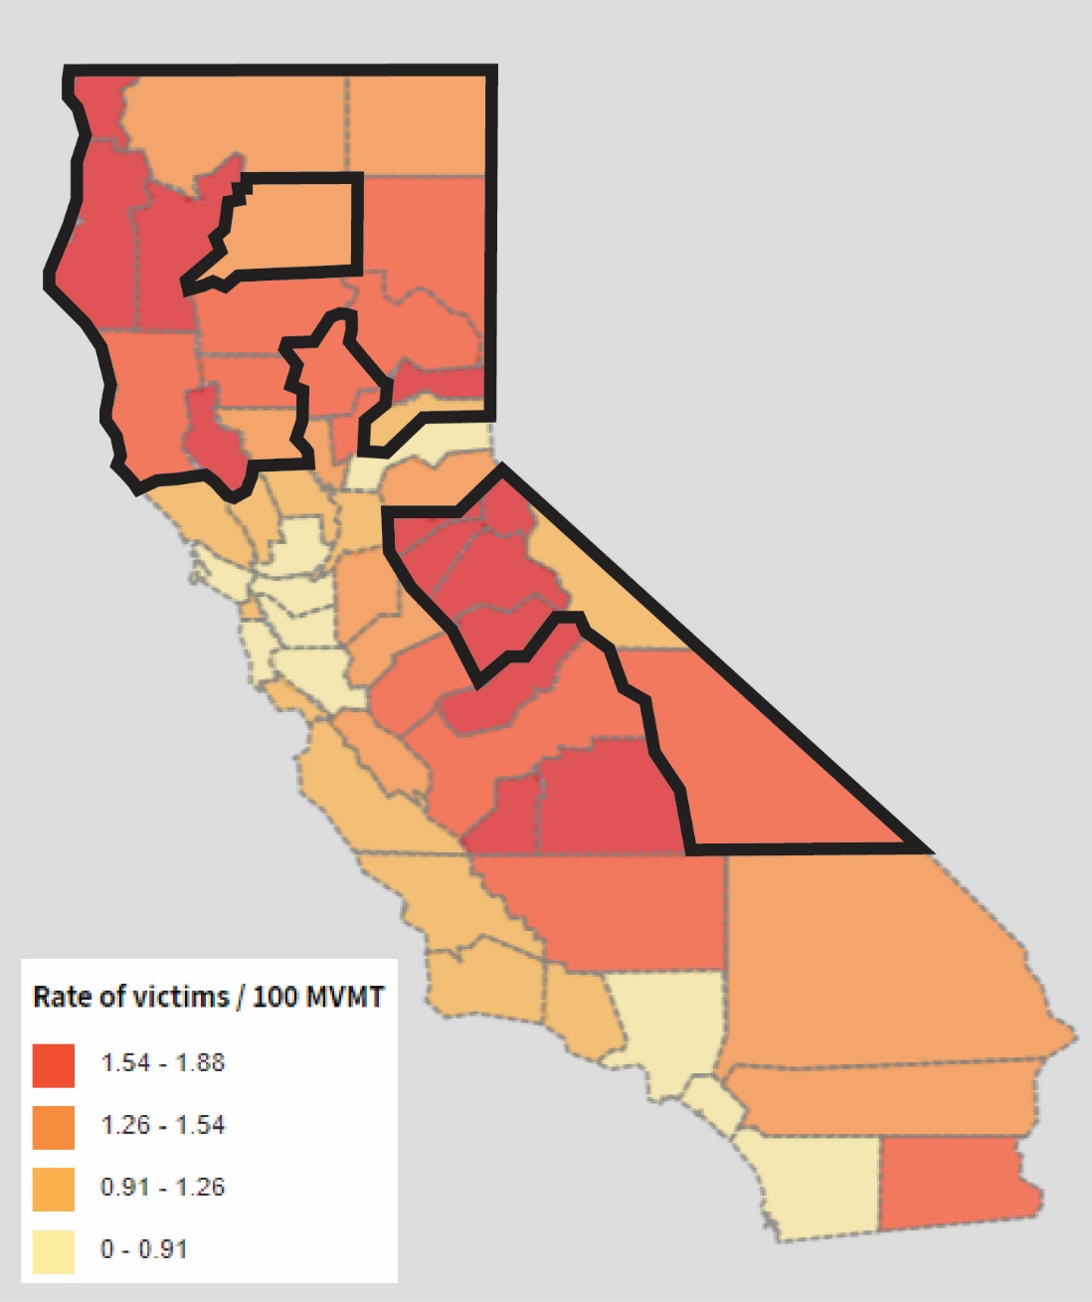
Rural Transportation Challenges
Safety
3.16 fatalities per 100 million vehicle miles on rural roads
0.77 fatalities per 100 million vehicle miles on urban roads5
5
8
Notes:
One of the major challenges for freight movement in rural California is safety. The rate of traffic fatalities on California’s rural roads is the second highest in the nation and is more than four times the fatality rate of all other roads in the state. Narrow winding roads are not adequate for high speed truck travel required for efficient goods movement and often lead to tragic accidents. Even multilane rural highways pose significant dangers, especially slow moving cross traffic (farm equipment and entering trucks), which conflicts with high speed truck traffic. In addition, agricultural truck travel is often timed to preferred harvest times, such as before dawn, which increase the danger.
And as capacity becomes an increasing issue in many rural counties, trucks often use more rural roads to avoid congestion, increasing the safety risk to the truckers and the driving public.

Slide 8
Rural Freight Challenges
Weather
Snow and severe weather
Increasingly severe weather events
5
9
Notes:
Although weather can be a challenge in any area of the state, the weather conditions experienced in many rural counties is often extreme. In particular, heavy snow in the north and mountain regions of the state often delays or restricts freight movement during winter months. Road closures can isolate rural communities and stop freight movement, especially since many remote rural communities do not have alternate routes.

Slide 9
Rural Freight Challenges
Funding
Limited funding/staff to perform mandated tasks
Limited funding for capacity improvements
Limited ability to raise sufficient local funds5
Limited resources to compete for federal & state funds
10

Slide 10
Rural Counties Opportunities
Collaboration
Rural Counties Task Force
12

Slide 11
California’s Rural Freight Movement
Questions???
13

