Slide 1
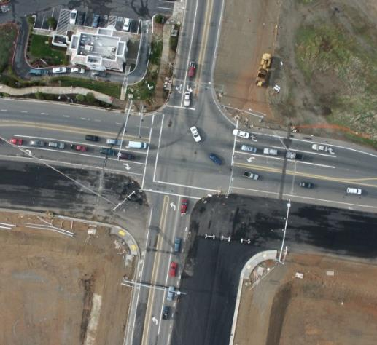
Is SB 743 an Evolutionary Change to CEQA Practice?

Slide 2
“All truth passes through three stages. First, it is ridiculed. Second, it is violently opposed. Third, it is accepted as being self-evident.”
- Arthur Schopenhauer, German Philosopher
“All CEQA changes pass through three stages. First, they are ridiculed. Second, they are legally opposed. Third, they are accepted after being validated by the courts.”
- Ronald T. Milam

Slide 3
SB 743
SB 226
SB 375
CEQA
PRACTICE
SB 97
AB 32
Regulatory changes
Have occurred but will continue to evolve (especially technical practices)…

Slide 4
Traditional Planning Process
Notes:
In fact, our conventional transportation planning process become a very linear, myopically focused, process often only considering one performance metric. I probably don’t even have to mention the metric’s name because it has become so predominant. Unfortunately, this planning process and the focus on a single metric resulted in plans that didn’t address all users or modes, nor did it recognize other important community values. Further, this process often created plans that couldn’t be implemented anyway because they were disconnected from financial reality. That might actually be a good thing since it has created opportunities to revisit, refine, and revamp these plans.

Slide 5
Land Use Plan Example

Slide 6
Transportation Plan Example

Slide 7
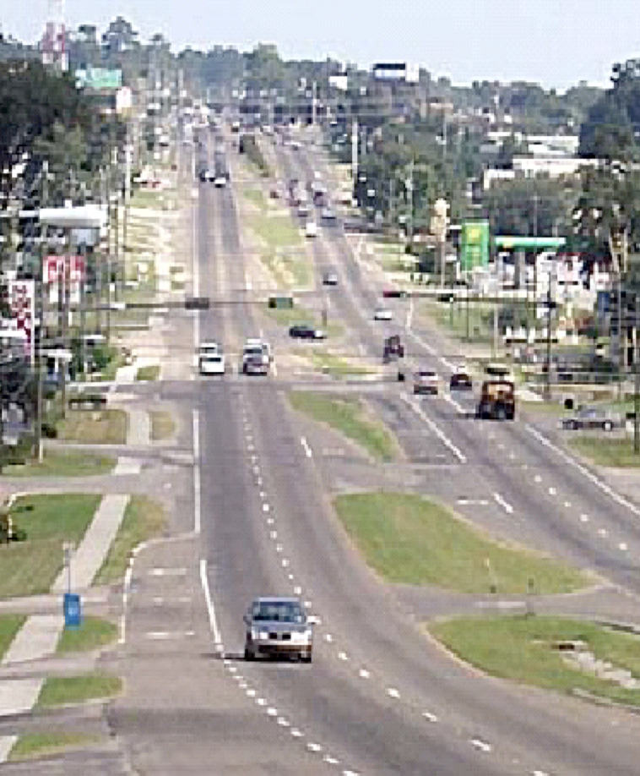
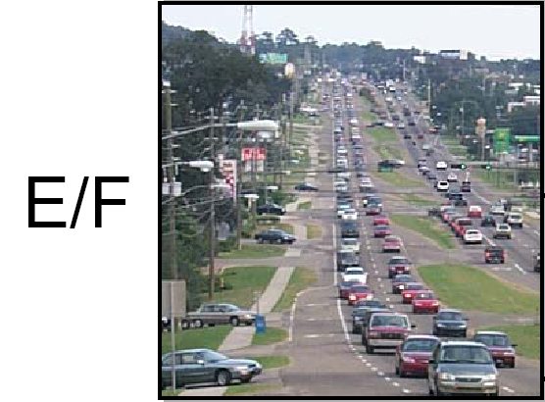
The Role of LOS
To a driver: LOS A
To a driver: LOS F
To an economist: LOS F
To an economist: LOS A
Notes:
LOS is the term most commonly used to describe transportation conditions. LOS has been utilized by traffic engineers for more than 50 years to qualitatively describe operating conditions for automobile travel on existing or planned roadway systems.
The Highway Capacity Manual, developed by the Transportation Research Board, defines LOS qualitatively based on measures such as speed, travel time, maneuverability, traffic interruptions, and driver comfort and convenience.
Most often, however, LOS refers to a specific quantitative measure: average vehicular delay at an intersection. The HCM specifies a methodology for calculating this value based on a combination of theoretical and empirical data.
Determining what LOS threshold is “acceptable” is left up to local jurisdictions

Slide 8
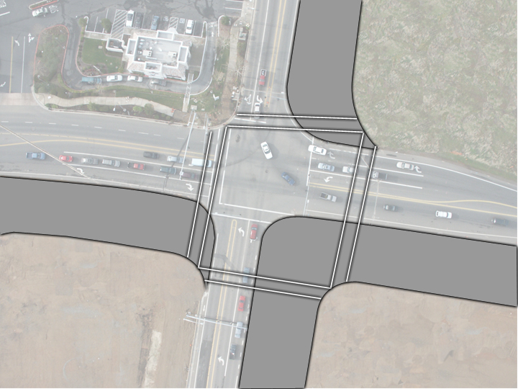
Consequences of Current Practice
LOS mitigation usually requires expansion of the network
LOS based analysis generates impacts to other modes and the environment
LOS mitigation increases public long-term O&M costs
Notes:
The current use of LOS thresholds has two major consequences. First, LOS policies influence the type and size of infrastructure investments. As shown in the person-space slide, over-reliance on these policies can bias the selection of infrastructure investments toward automobile-oriented projects. In fact, automobile LOS is often used as a design threshold for transportation facilities, under the constraint that other modes such as bikes and pedestrians simply be “accommodated.” The picture above shows the consequences of attempting to maintain LOS C for automobiles during peak hours.
The second consequence of current practice regarding LOS policies is an influence on land use form. For example, given the choice between an infill development and a site located on the urban or suburban fringe, many developers will choose the more rural site in order to avoid potential LOS-related impacts and the associated mitigation costs. This not only encourages sprawl, but may actually increase the length of trips that people have to make.

Slide 9
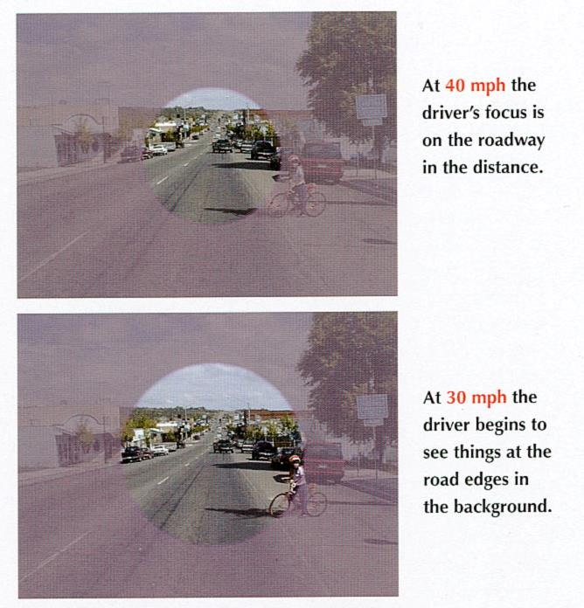
Consequences of Current Practice
Source: Smart Mobility Framework, Caltrans, 2009

Slide 10
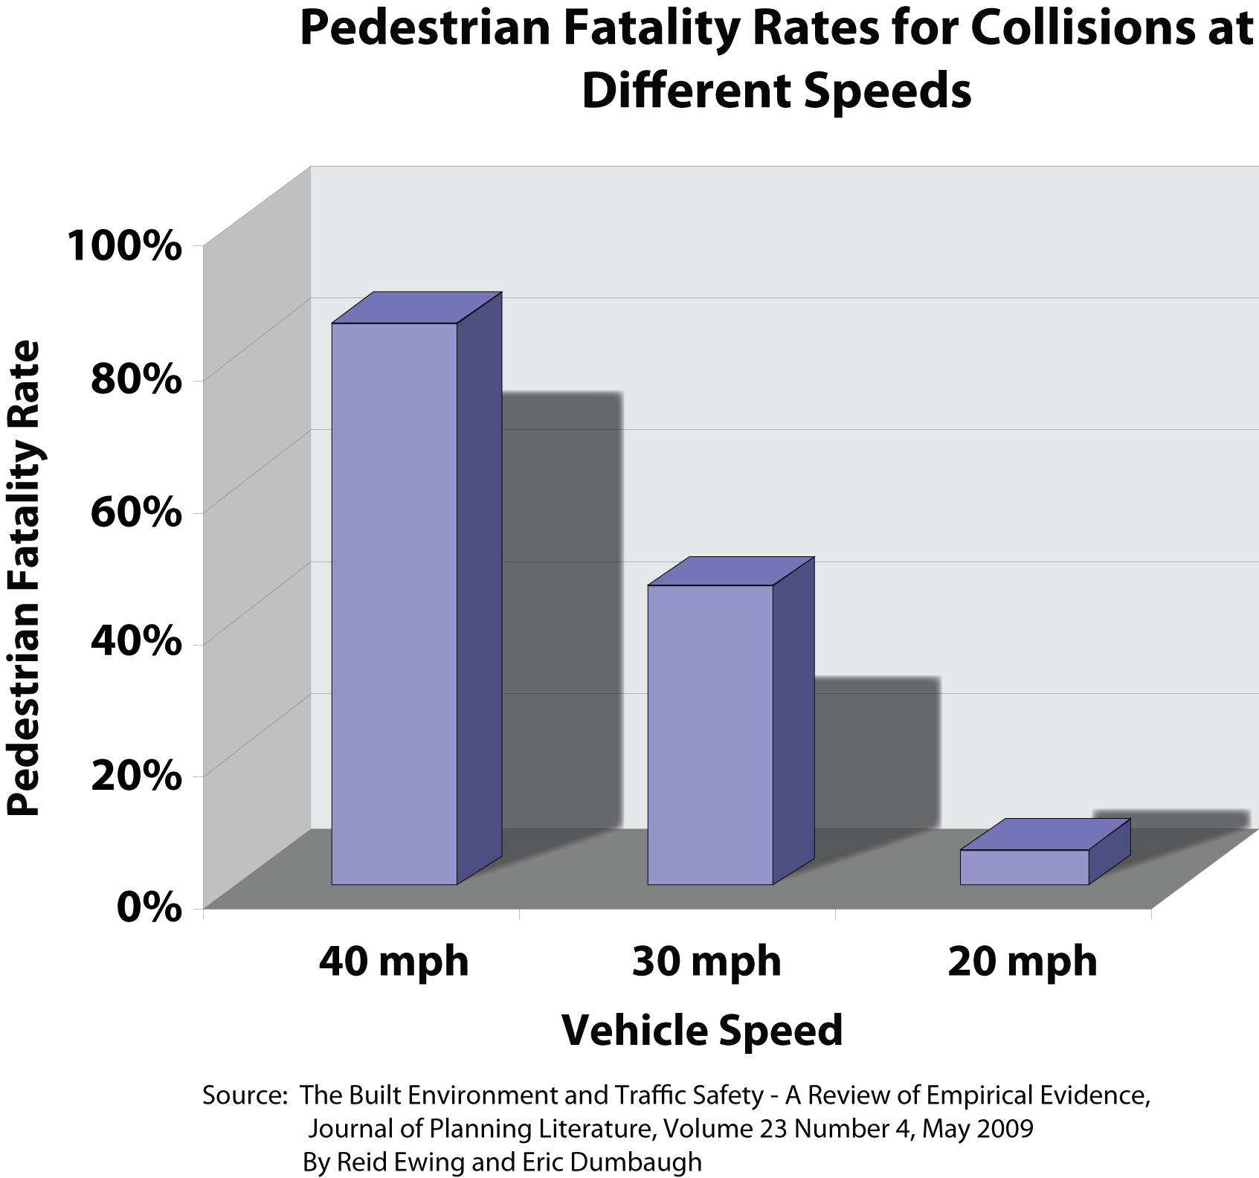
Consequences of Current Practice
Notes:
Just a few more of the choices and consequences…
- Pedestrian fatalities are directly related to vehicle speed

Slide 11
Urban Form Consequences
Notes:
Just a few more of the choices and consequences…
Street metrics (and design standards) are directly related to how we use urban (public space). In the early 20th century the area dedicated to driving and parking was about 20 percent.
This increased to about 40 percent by the early 21st century. Between these two centuries, street metrics and zoning both contributed to regulations that dictated more space for automobiles. In fact, during this time we standardized road design standards, parking standards, invited the auto into our homes, gave it its own room (called the garage) and specified the amount of space to preserve for it. Didn’t do this for the humans by the way..

Slide 12
Urban Form Consequences
Notes:
Just a few more of the choices and consequences…
Looking at the glass as half full, you could say that we have more public space (could be a good thing) but you’d have to ask how we are using the gained space?

Slide 13
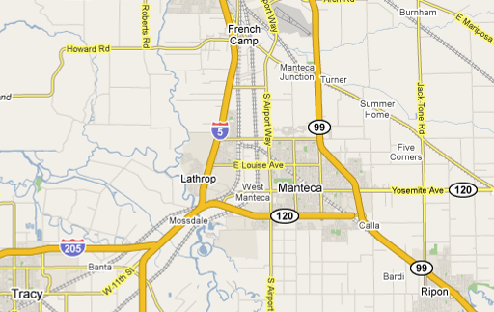
Case Study – City of Manteca
Current fee imposed per DUE | Fee to meet LOS C threshold
$5,400/DUE | $37,000/DUE

Slide 14
The New Planning Paradigm - Shifting the Process

Slide 15
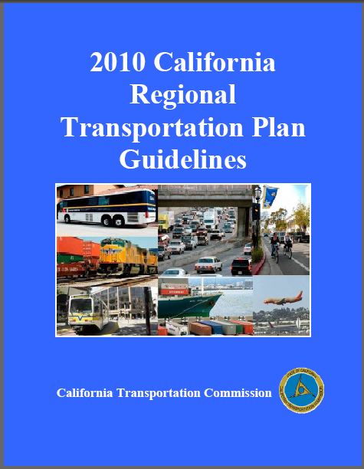
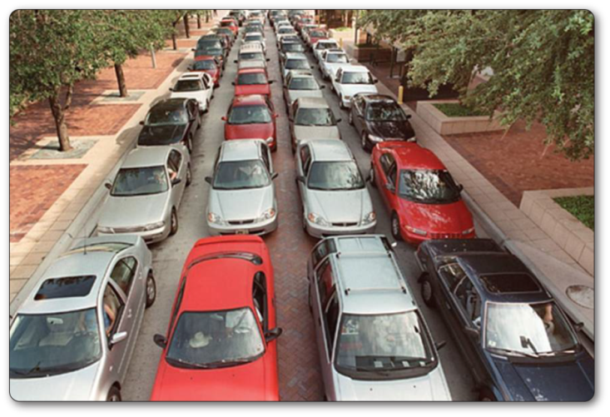
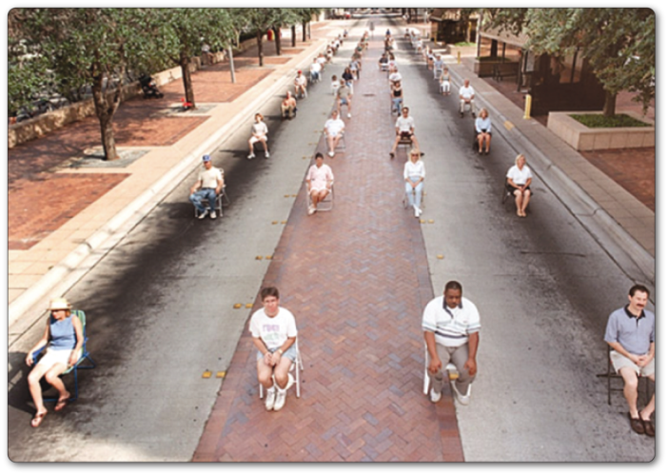
Transportation Analysis Evolution…
Regulatory environment placing a spotlight on travel forecasting models (SB 375, SB 743)
Redefining the ‘problem’ – Accessibility vs. Mobility
Shifted Transportation Planning and Impact Focus
Vehicle miles of travel (VMT)
Travel choices
Balancing multiple objectives
Increased awareness about disconnect between general plans and CEQA

Slide 16
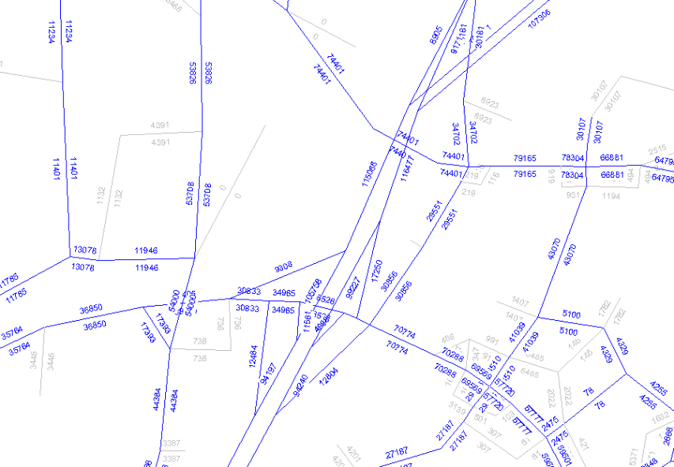
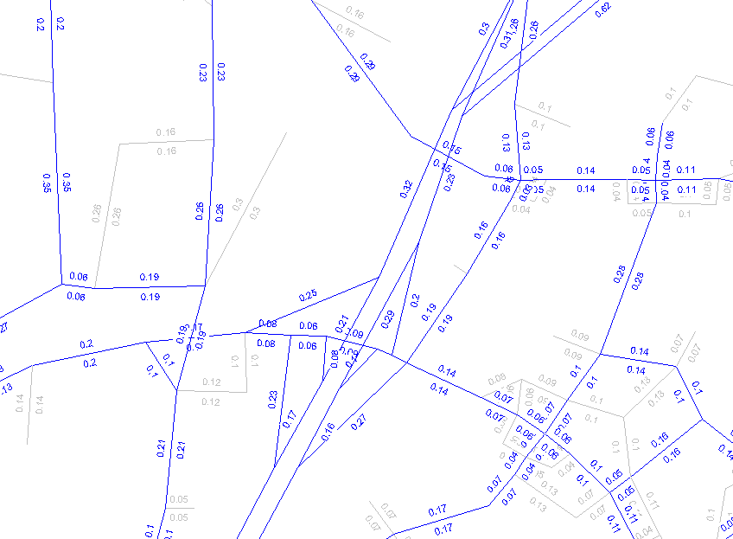
VMT = Volume (or Trips) x Distance

Slide 17
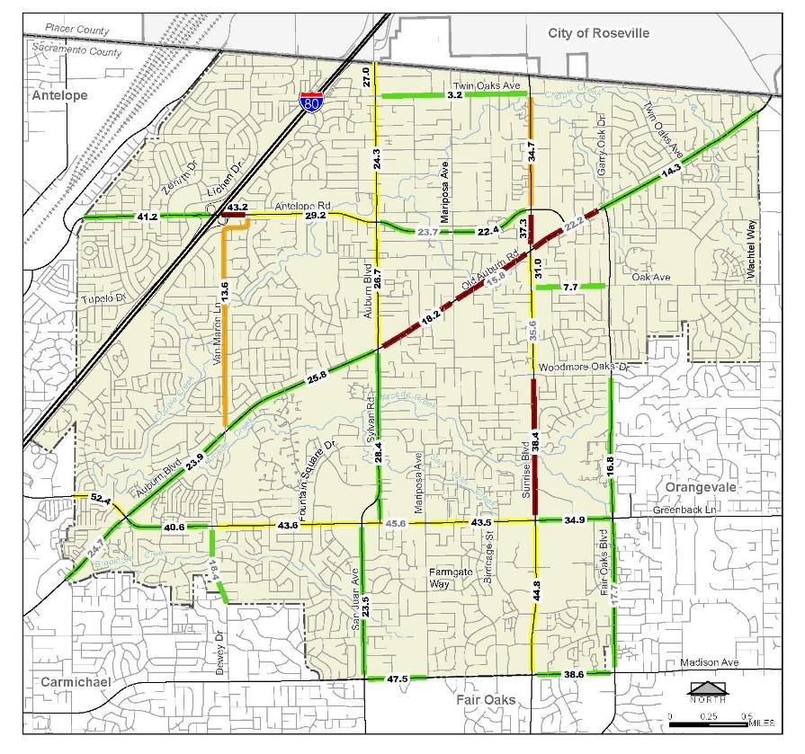
Boundary VMT Method
Traffic count based estimate (speed not a factor)
Estimate depends on traffic count coverage and quality
Only captures VMT on jurisdiction’s roadways
Citrus Heights = 1,000,110 daily VMT (weekday)

Slide 18
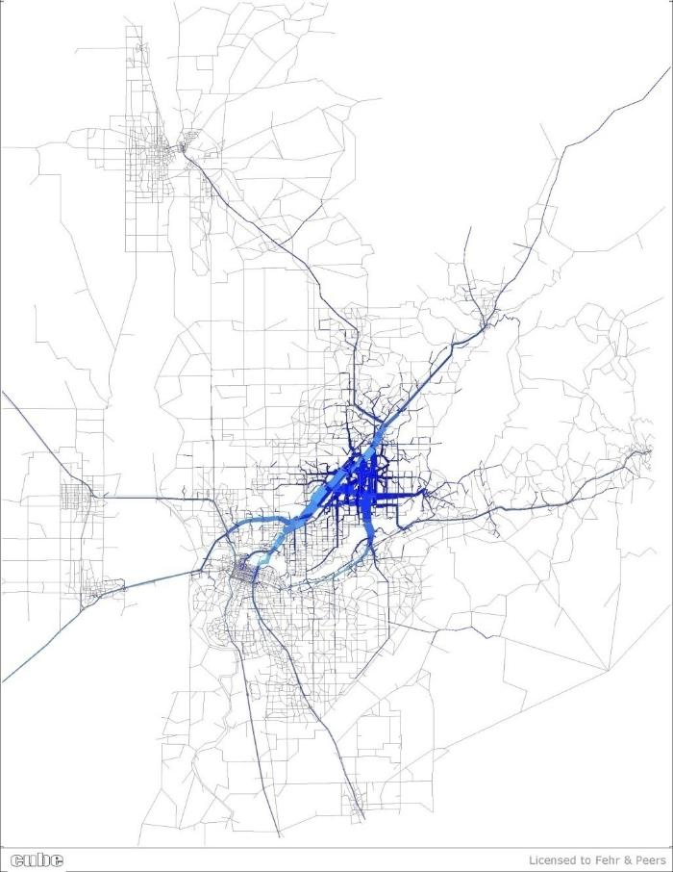
Travel Model VMT Method
Traffic volume and speed based estimate
Volumes derived from trips generated by land uses or activities
Estimate depends on model form, limits, and data quality
Can capture VMT multiple ways
Citrus Heights = 1,397,340 daily VMT (weekday)

Slide 19
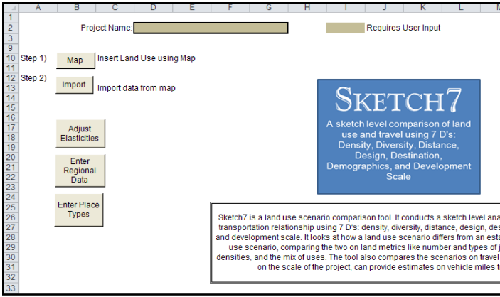
‘Sketch’ Model VMT Methods

Slide 20
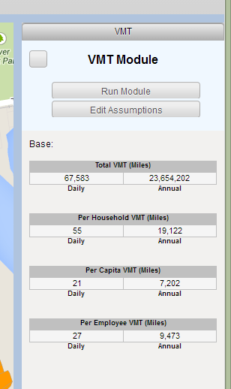
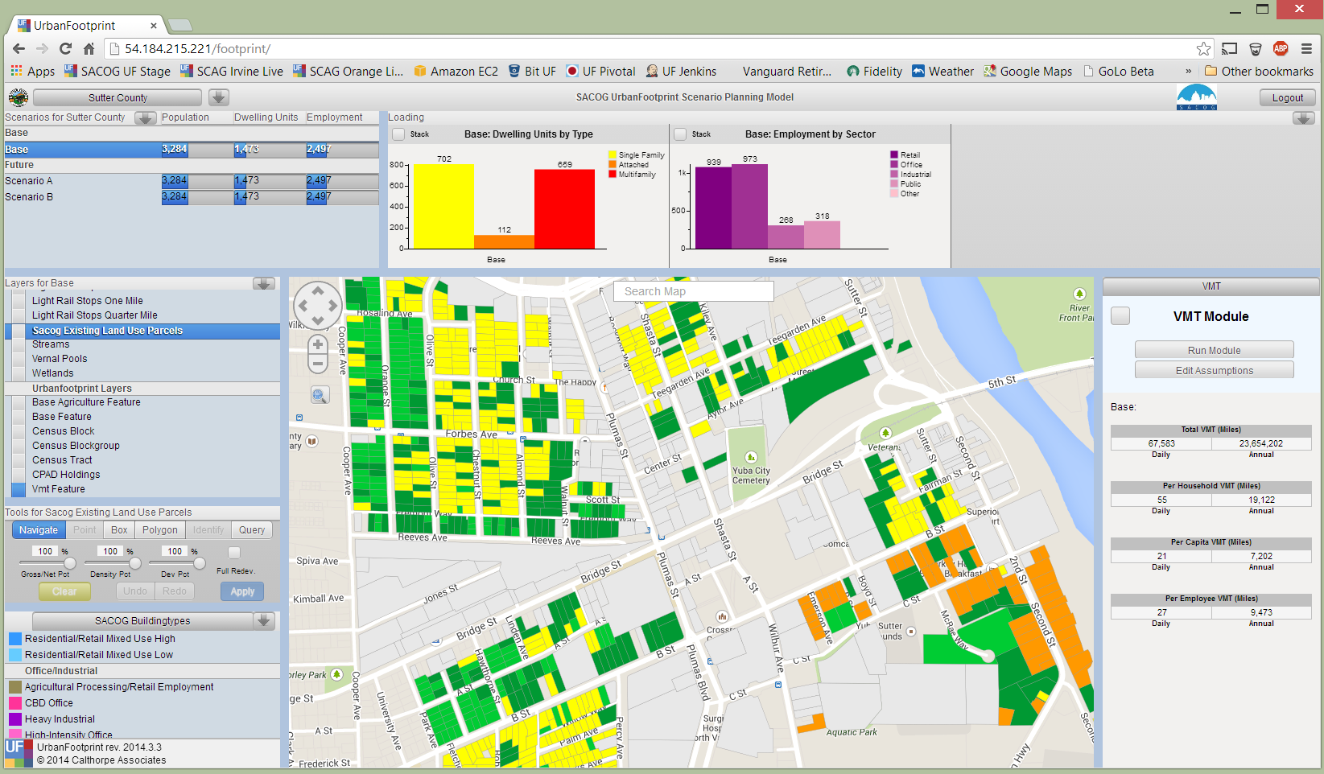
UrbanFootprint – VMT Module
Sample Results
Source: Calthorpe

Slide 21
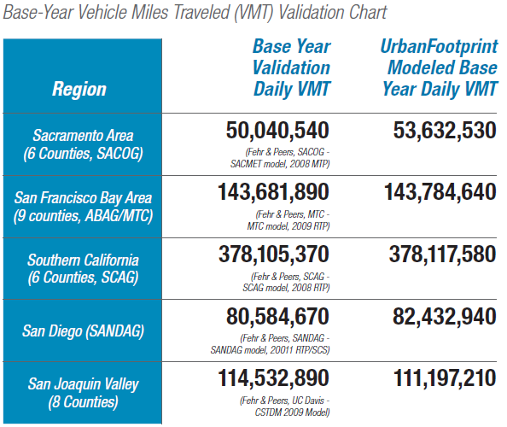
VMT Validation
UrbanFootprint

Slide 22
VMT Apples vs. VMT Oranges
Trip Length Estimates | Average Trip Length by Trip Purpose
 | HBO | HBS | HBW
CalEEMod | 7.50 | 7.30 | 10.80
VMT Spreadsheet Model | 7.22 | 7.22 | 12.54
MPO Travel Forecasting Model | 7.26 | 7.26 | 5.87
Notes: HBO = Home-Based Other HBS = Home-Based Shopping HBW = Home-Based Work
Notes:
22

Slide 23
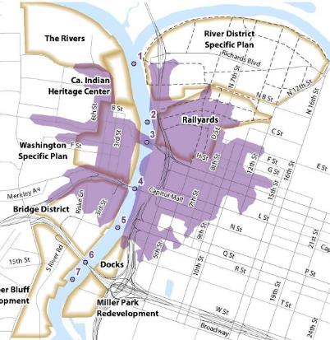
Accessibility
Mobility
What SB 743 Proposes To Do
Potentially adds accessibility to CEQA analysis

Slide 24
What SB 743 Does Not Do
No change to general plans, traffic impact fee programs, State Constitution, subdivision map act, etc.

Slide 25
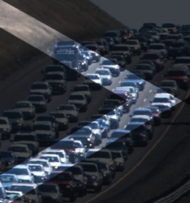
Section 15064.3 (b)(1) - Development Project VMT
Development
Project VMT
Regional average for similar land use types
Understanding the thresholds
How much discretion will lead agencies have?
Are guidelines consistent with the statute?

Slide 26
Other Justifications for Thresholds
Governor’s Executive Orders
SB 375 Targets
Caltrans Strategic Management Plan target
Development
Project VMT

Slide 27
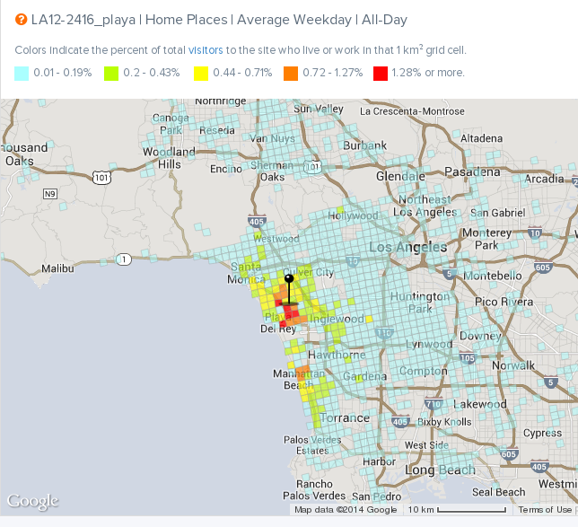
VMT by Land Use Type
How should it be calculated?

Slide 28
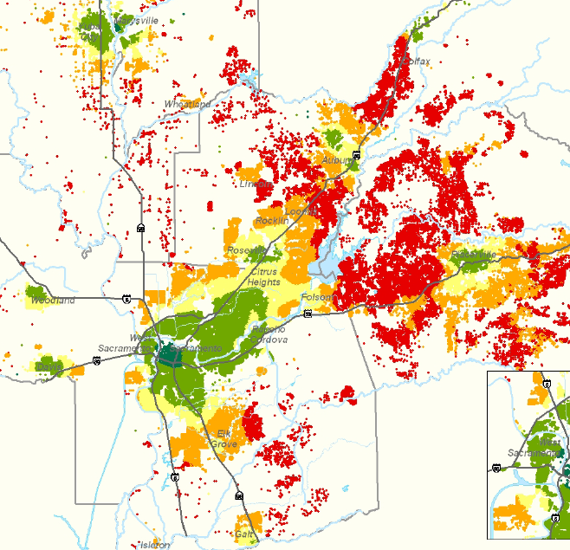
Residential VMT
What’s acceptable?
Source: SACOG

Slide 29
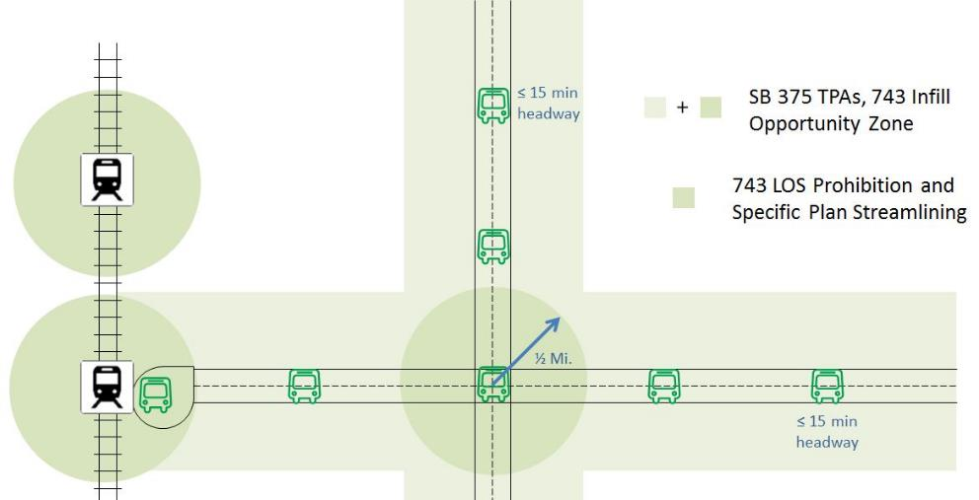
Section 15064.3 (b)(1) - Development Project Location
Understanding the thresholds
How much discretion will lead agencies have?

Slide 30
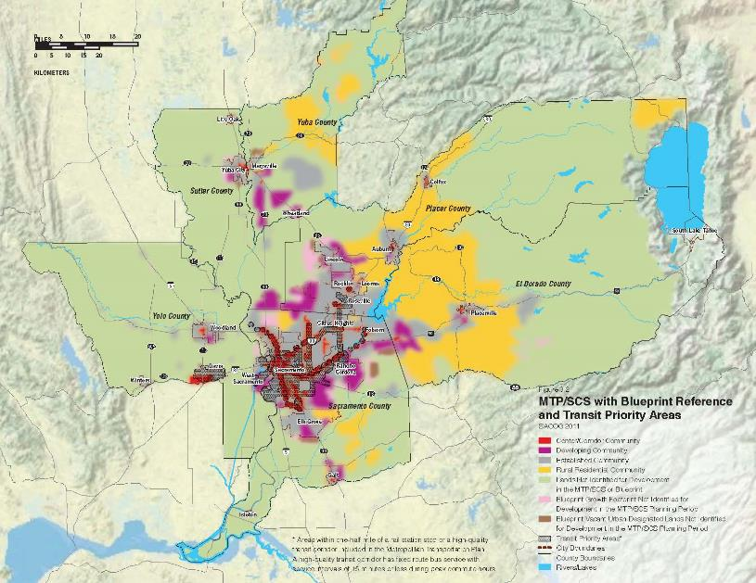
Section 15064.3 (b)(1) - Land Use Plan/SCS Consistency
Understanding the thresholds
How much discretion will lead agencies have?

Slide 31
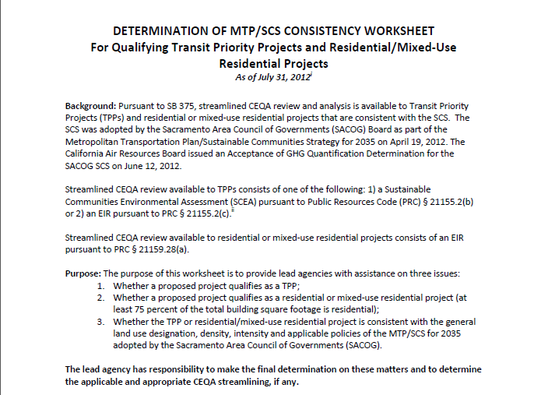
Understanding the thresholds
How much discretion will lead agencies have?

Slide 32
Section 15064.3 (b)(2) - Induced Travel
<> | <> | <> | <> | <> | <> | <> | <> | <> | <> | <> | <> | <> | <> | <>
General Purpose lanes vs.
Managed or Auxiliary lanes
Understanding the thresholds
How much discretion will lead agencies have?

Slide 33
Section 15064.3 (b)(3) - Local Safety
AND
Revised Appendix G
Are these thresholds?
The influence of the CEQA Guidelines and dealing with tradeoffs
Copyright: <aref='http://www.123rf.com/profile_leaf'>leaf / 123RF Stock Photo</a>
Notes:
(3) Local Safety. In addition to a project’s effect on vehicle miles traveled, a lead agency may also consider localized effects of project-related transportation on safety. Examples of objective factors that may be relevant may include:
Increase exposure of bicyclists and pedestrians in vehicle conflict areas (i.e., remove pedestrian and bicycle facilities, increase roadway crossing times or distances, etc.).
(B) Contribute to queuing on freeway off-ramps where queues extend onto the mainline.
(C) Contribute to speed differentials of greater than 15 miles per hour between adjacent travel lanes.
(D) Increase motor vehicle speeds.
(E) Increase distance between pedestrian or bicycle crossings.

Slide 34
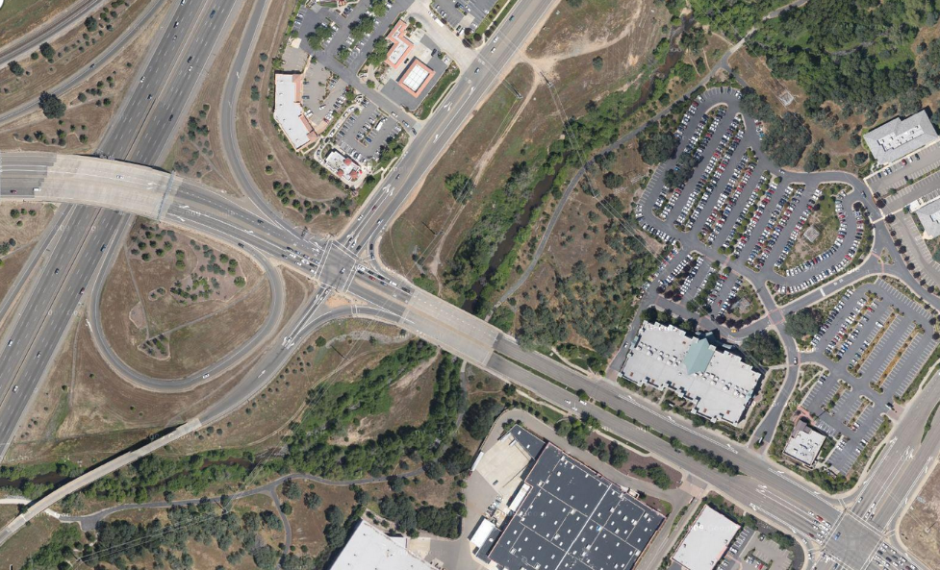
What About Infrastructure Projects?

Slide 35
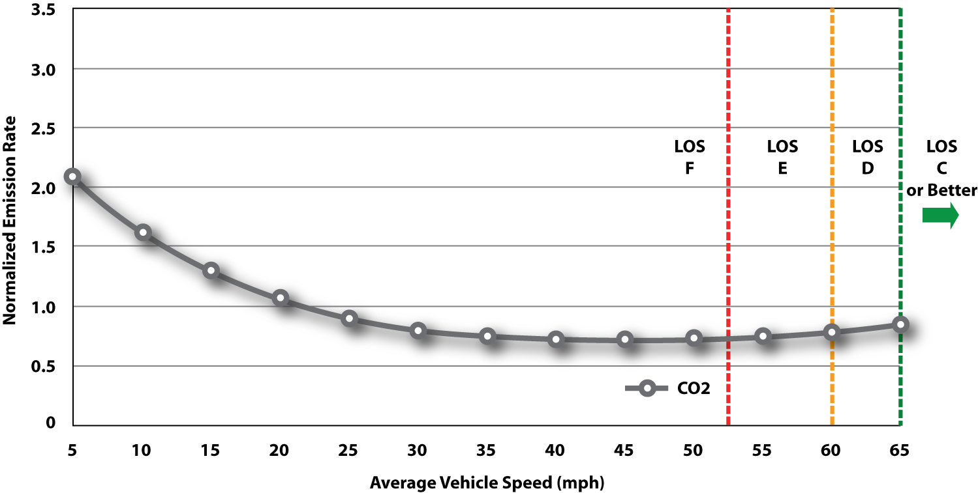
With VMT, Speed Matters….
Relationship of Freeway LOS, Speed, and CO2 Emissions Factors

Slide 36
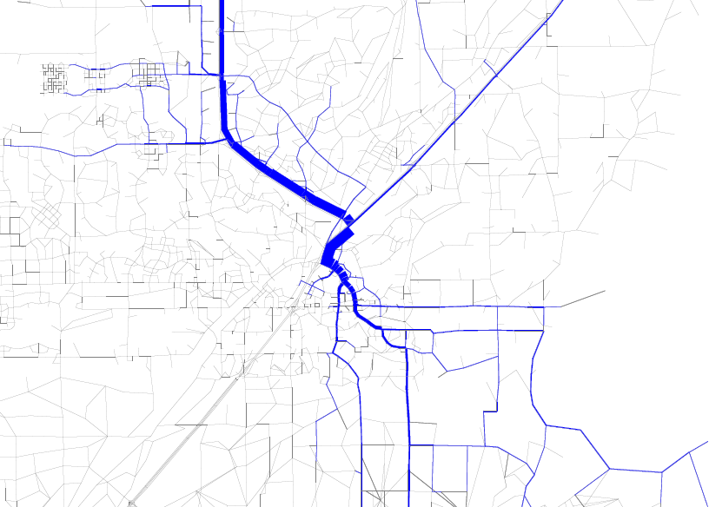
VMT vs Fuel Consumption Need to determine the Study Area, the Methodology, and the Threshold

Slide 37
Conflicting Results?
GHG Emissions Estimate Method | GHG Emissions (1,2) | Project Impact
Method 1 – VMT | 1,760 lbs | YES
Method 2 – VMT by Speed bin and EMFAC | - 60 lbs | NO
Method 3 – Microsimulation (VISSIM) | -171 lbs | NO
Notes: (1) Difference between project and no project under design year conditions. (2) CO2 Equivalent
What about induced travel?

Slide 38
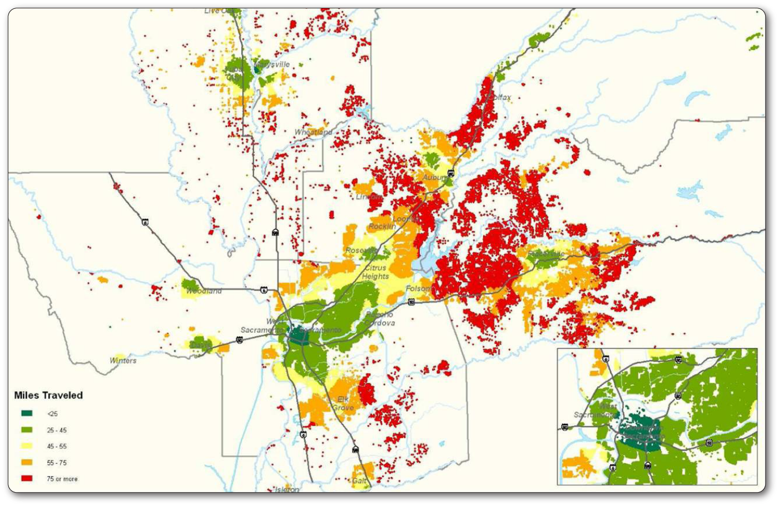
Case Study – Yolo County General Plan

Slide 39
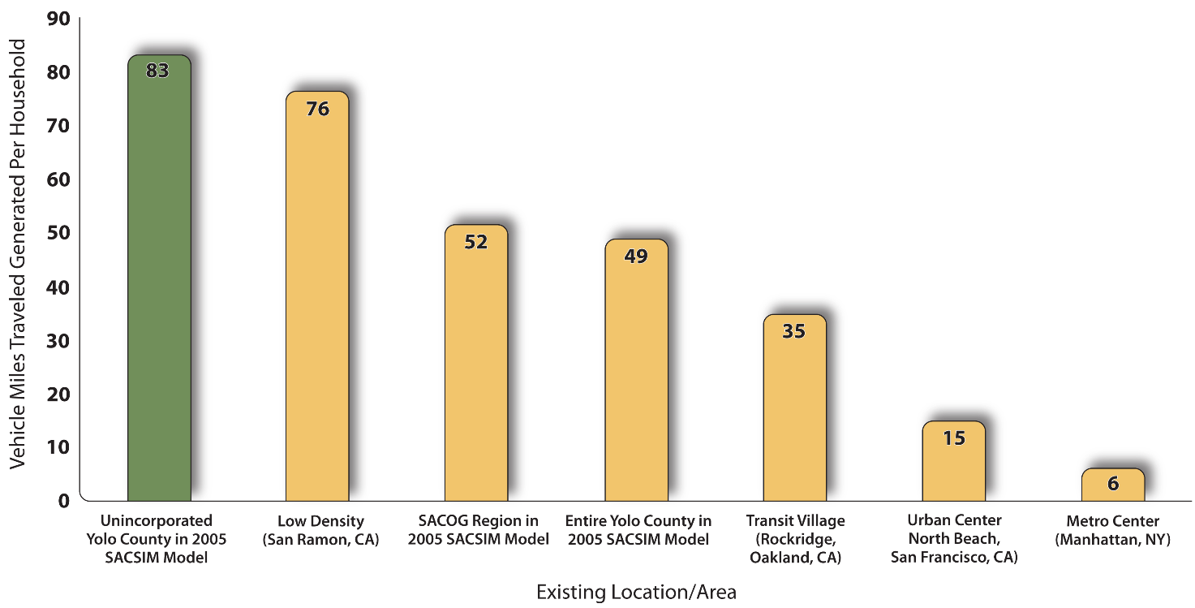
Comparison of Daily Vehicle Miles by Land Use Pattern

Slide 40
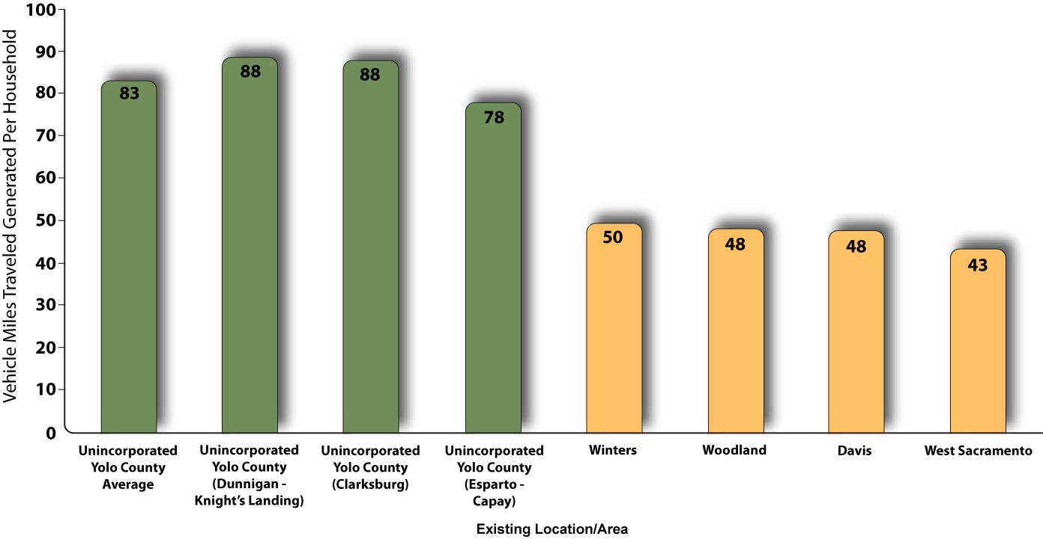
2005 Daily VMT for Yolo County

Slide 41
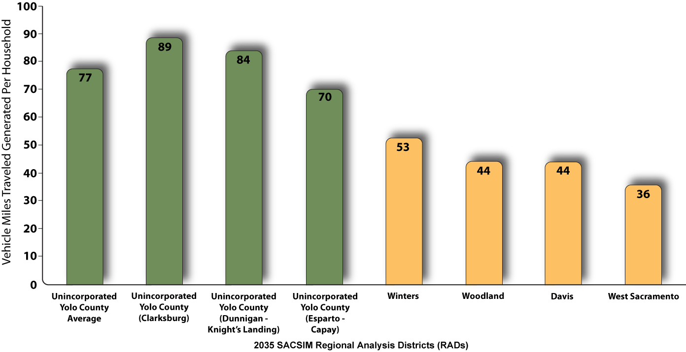
2035 Daily VMT for Yolo County
New General Plan Policy:
Add a VMT Threshold

Slide 42
Next Steps When will SB 743 go into effect?
New draft this summer
OPR incorporates comments
Draft to Resources Agency for formal rulemaking process
Office of administrative law
Guidelines take effect
Opt-in period
Statewide implementation

Slide 43
Thanks!
Ronald T. Milam, AICP, PTP, Principal
r.milam@fehrandpeers.com

